Slide 1

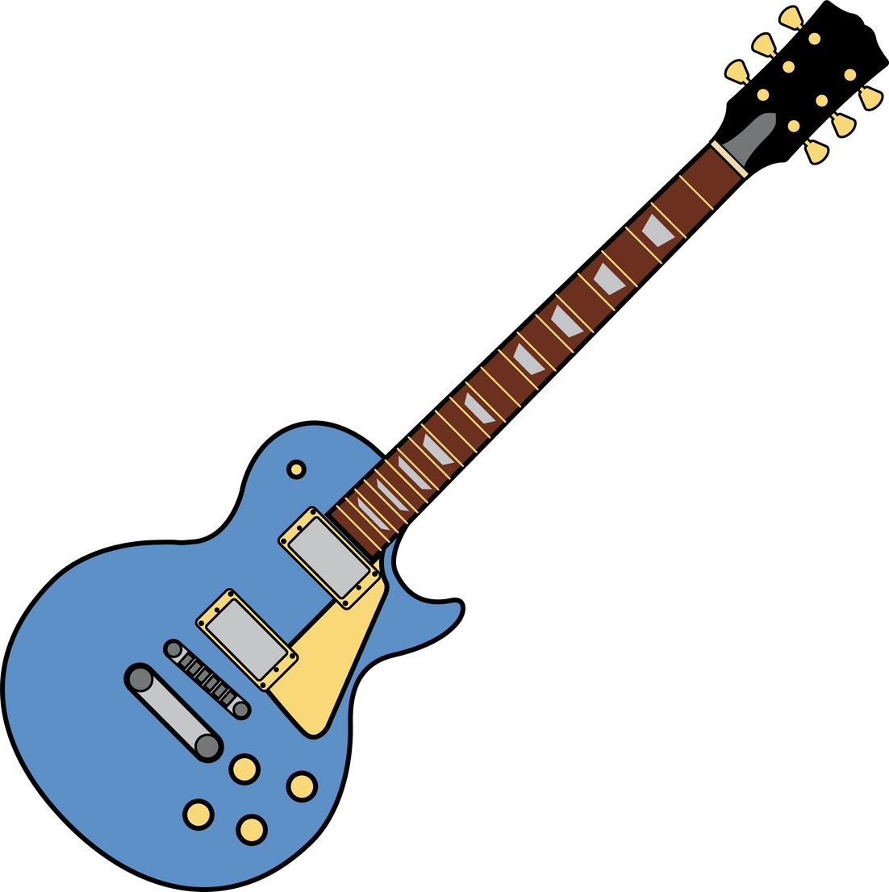
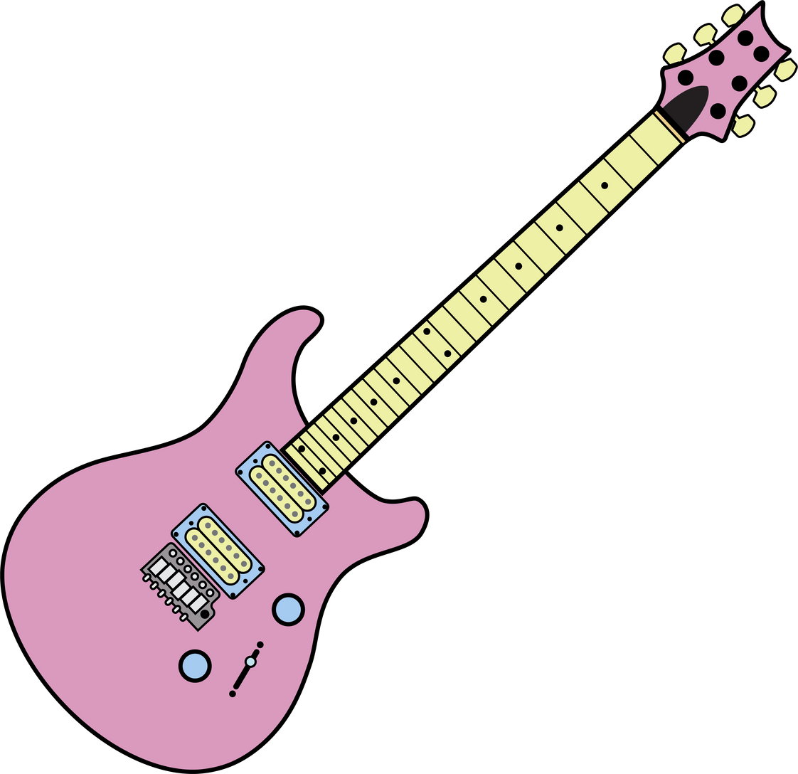
Electric Guitar Body Detection: A Machine Vision Approach
Exploring Template Matching and Haar Classifiers
Team Composition:
Kavvousanaki Evangelia
Kapsalis Christoforos
Proiskos Georgios
Stavrogiannis Christos

Slide 2
Research Goals
Develop a tool to detect and classify guitar body types in images
Improve automation in image-based content tagging
Make progress towards the analysis of the impact of guitar body types physical characteristics in audiovisual advertising

Slide 3
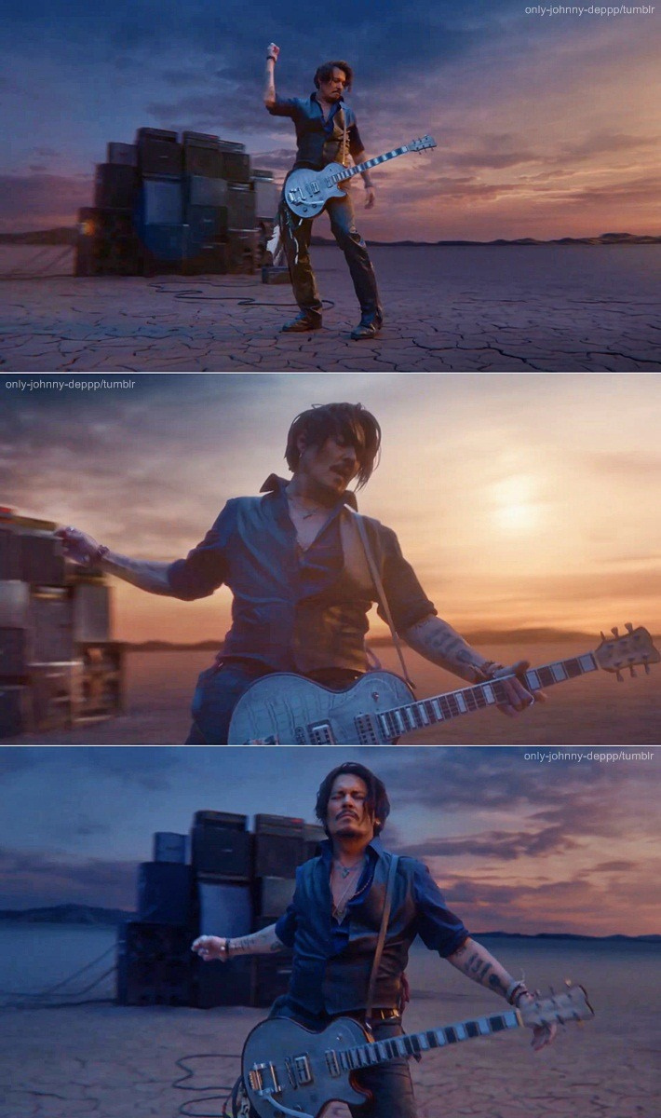
Motivation - Why Focus on Electric Guitar Bodies?
The cultural and symbolic status of electric guitars
Strong visual impact in marketing and advertising
Lack of research on physical guitar characteristics

Slide 4
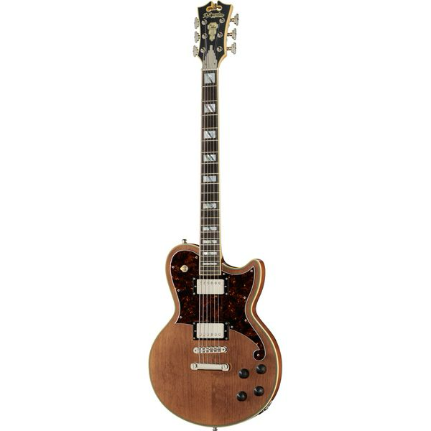
Data Collection
Web Crawler Development
Thomann.de posed as a promising source of “clean” guitar images to utilize in all our approaches.
Uniform Lighting & Consistent Illumination: The lighting across the image is even, without harsh shadows or bright spots.
Minimal Background Clutter & Plain Background: The background is simple and consist of a single (in each image) color with strict “bands” in each case.
Developed an agent using python’s Playwright library to download guitar photos, classifier per their body type.

Slide 5

Data Validation and Cleaning
Data Cleanup
Some images retrieved by the crawler were rotated or showed the back sides of guitars, so we performed a manual cleanup to replace such cases with “clean” instances.

Slide 6
Approach 1 - Naive Template Matching
Problem Statement
We are looking at clean cases of image photos and want to be able to automatically detect the depicted guitar body types.
End Goal
Creation of generalized one-piece full-body binary mask templates for each guitar type.
Guiding principles:
Broad Applicability
Automation
Numerical expression of distinguishing features going beyond what our experience suggests

Slide 7


Approach 1 - Challenges & Assumptions
Fundamental Assumption:
There is a “definitive shape” for each guitar type.
We sticked to the task of recognizing the hallmark models of the industry giants, Fender and Gibson.
Stratocaster - “ST”
Telecaster - “T”
Les Paul - “LP”
Solid Guitar - “SG”

Slide 8
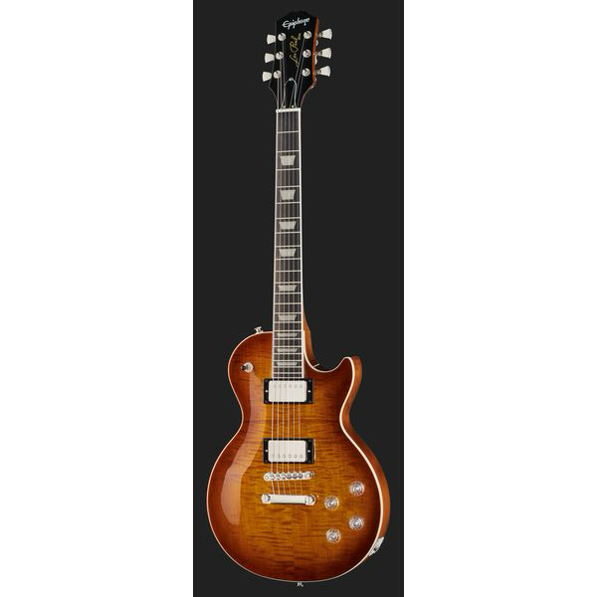
Approach 1 - Challenges & Assumptions
Image Size, Scaling, Rotation, Lighting Conditions
The retrieved “training” images seemed to have all the previous features consistent among them - out of our control, we needed to assume it to generally hold.
Background Variations:
Both “light” and “dark” background photos, with the latter only having a “dark” part in the proportion displaying the guitar.

Slide 9
Approach 1 - Steps Implemented
Considering only the Luminance Channel
More convenient and efficient to work with a single-color channel.
Histogram-Based pre-processing:
Kept only the ‘central’ part portraying the guitar.
Automatically detected the two cases of backgrounds for images based on histogram observations.
Image Blurring
Gaussian with low-sigma theoretical normal distribution to prevent over-smoothing edges.

Slide 10
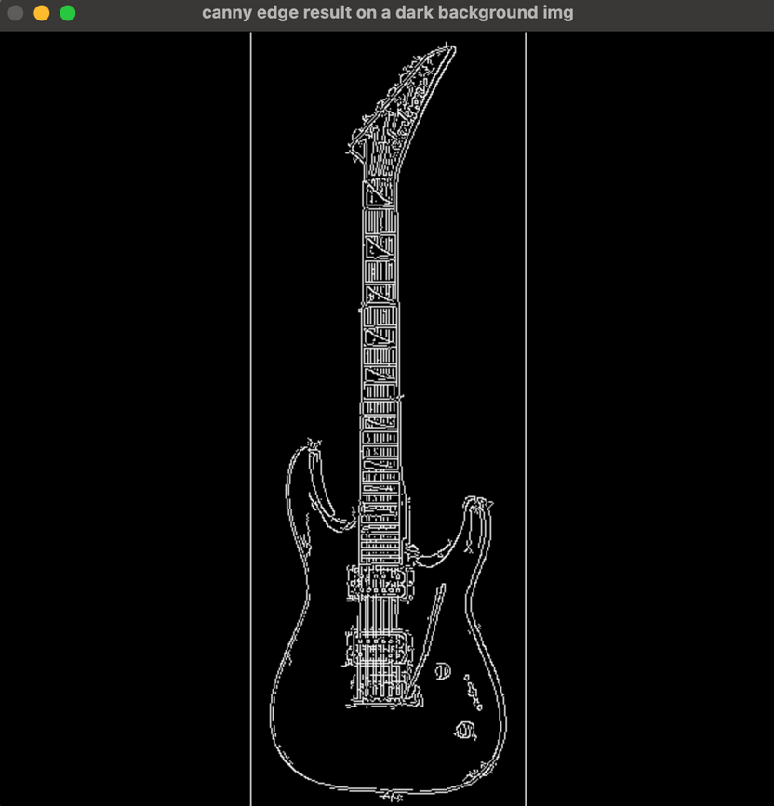
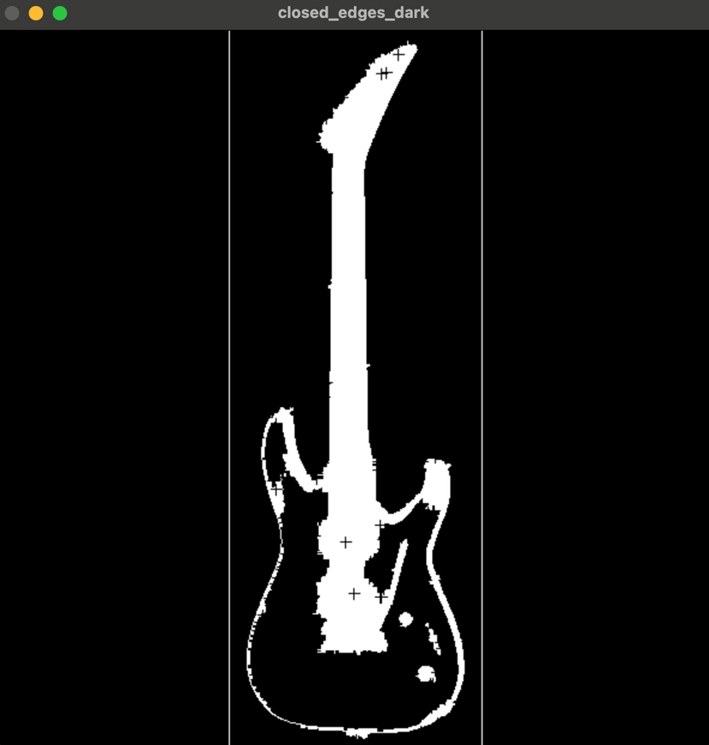
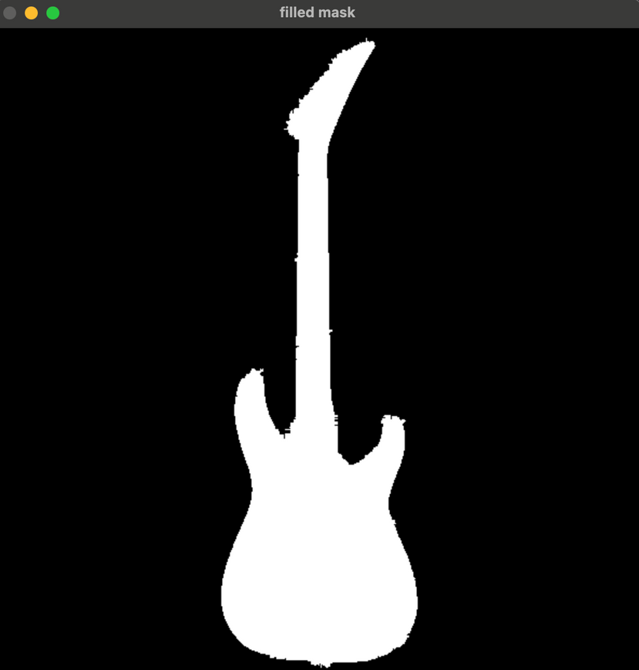
Approach 1 - Steps Implemented
Canny Edge Detection
Preserve more details.
Filling-in the detected edges - “Closing operation”
Largtest Contour Detection & Closing
CHAIN_APPROX_SIMPLE function for efficiency purposes.

Slide 11

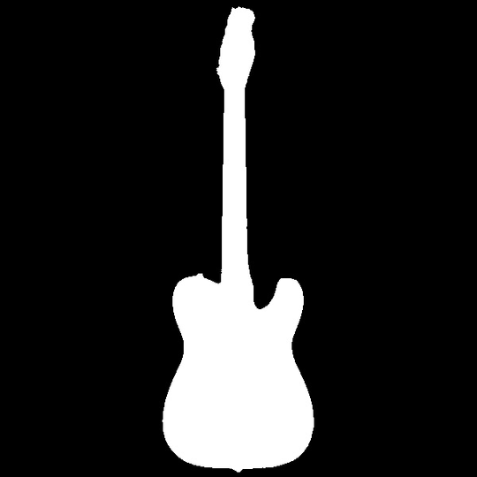

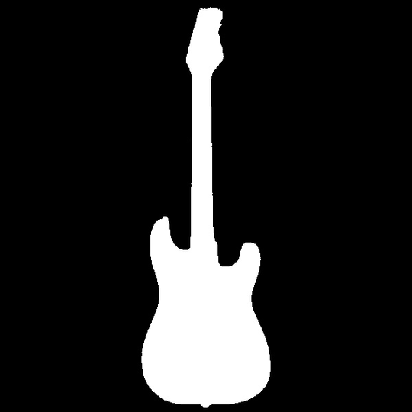
Approach 1 - Generalized Templates
Mask Generalization
Done via iterating over (~100) images of each type and averaging the results.
SG
T
LP
ST

Slide 12
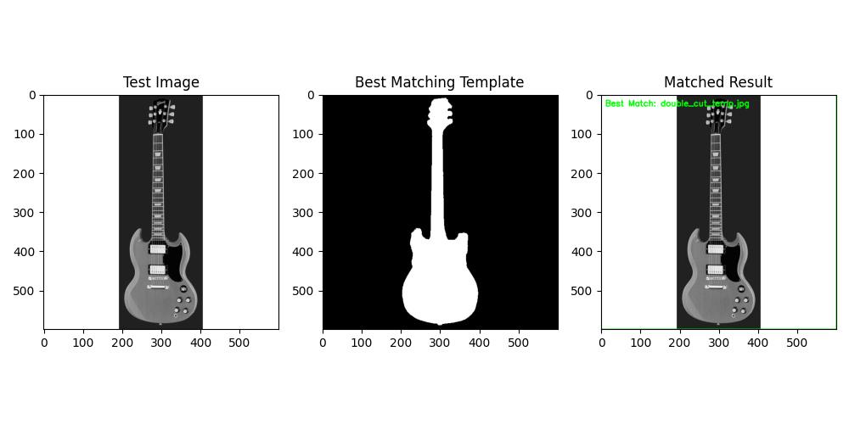
Approach 1 - Matching Example w/o Rotation & Scaling Considerations

Slide 13
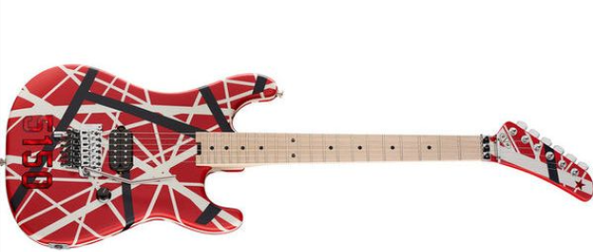
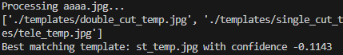

Approach 1 - Matching Example w Rotation & Scaling Considerations
Image Rotation & Template Matching (2D)
Initial Focus: 2D Rotation (z-axis)
Simple and quick to test.
Used rotate2D function from cv2, testing all possible angles
Initially, rotated sample images by 90 degrees to observe changes in confidence.
Visual Comparison: Confidence levels between rotated images.

Slide 14
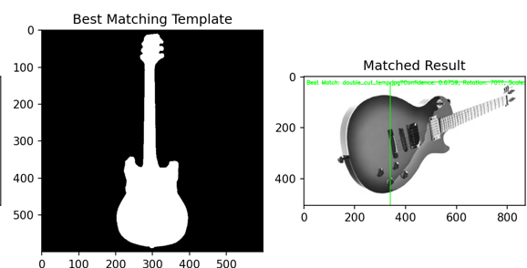
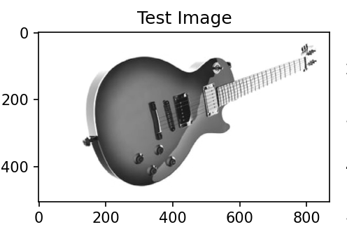
Approach 1 - Matching Example w Rotation & Scaling Considerations
Template Matching with Transformations: Tried to match templates to a test image by applying different transformations like rotation and scaling.
2D Rotation (z-axis): Rotated templates around the z-axis in 5-degree steps, checked which rotated version matches best.
3D Rotation (x and y axes): We also simulated 3D rotations by rotating templates along the x and y axes at specific angles (0, 45, 90, and 180 degrees).
Image Pyramid for Multi-Scale Matching: Created “pyramid of images” by resizing the test image and templates to check for matches at various scales. [0.2-2.0]
Best Match: Compared all these rotated and scaled templates and identified the one with the highest match score. Confidence was close for several types.

Slide 15
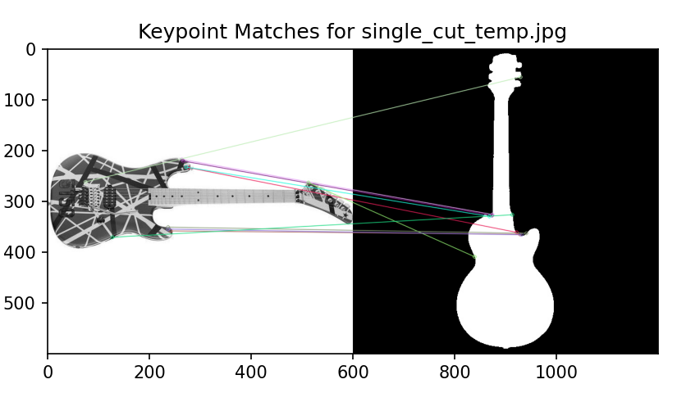
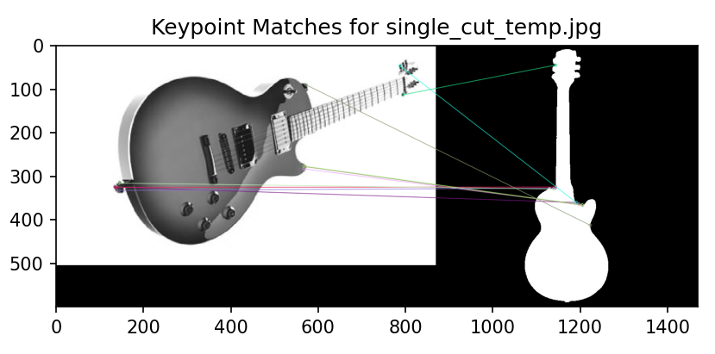
Approach 1 – Rotation Scaling w key point matching
Image Pyramid and Template Matching & Rotation and Scale Variations as previously.
Keypoint Matching with ORB: When the confidence scores between two matches was close, we performed keypoint matching using ORB (Oriented FAST and Rotated BRIEF) to improve precision.
Results Visualization: The best matches are displayed, showing confidence score, rotation angle, and scale of the template, with visual overlays of the results, but the effort did not yield better results.

Slide 16
Approach 2 - Haar Classifier Approach
Motivation
Failure of previous naive approach to generalize on suboptimal images.
Haar approach: initially developed for face-detection applications.
However, guitars also bear characteristics that portray high variance between cases yet their position and overall outline is predictable, at least among guitars of the same type.
End Goal
Training and usage of a Haar Classifier for guitar detection on images.
Then, should this succeed, we could develop multiple classifiers to try and detect the various types, should a guitar exist on an image.

Slide 17
Approach 2 - Challenges
No Training nor Testing Datasets Available
Unable to find any training dataset containing annotated guitar objects
Visual Complexity of Guitars
Variations in guitar features probably higher than facial characteristics - potential need for very large scale training set.
Limited Computational Resources
We were only able to execute a local implementation of this approach, allowing only for a short training period of our algorithm.

Slide 18
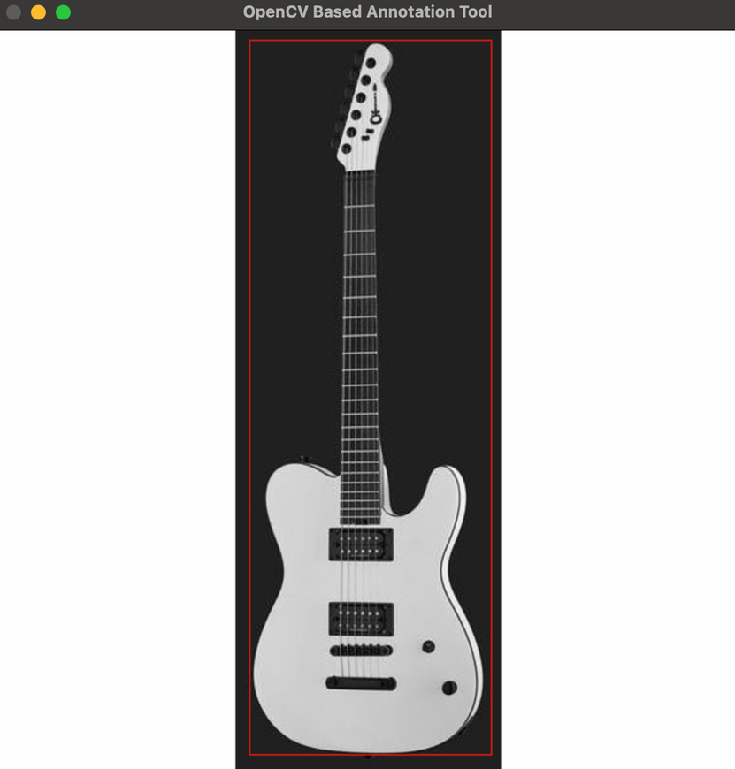
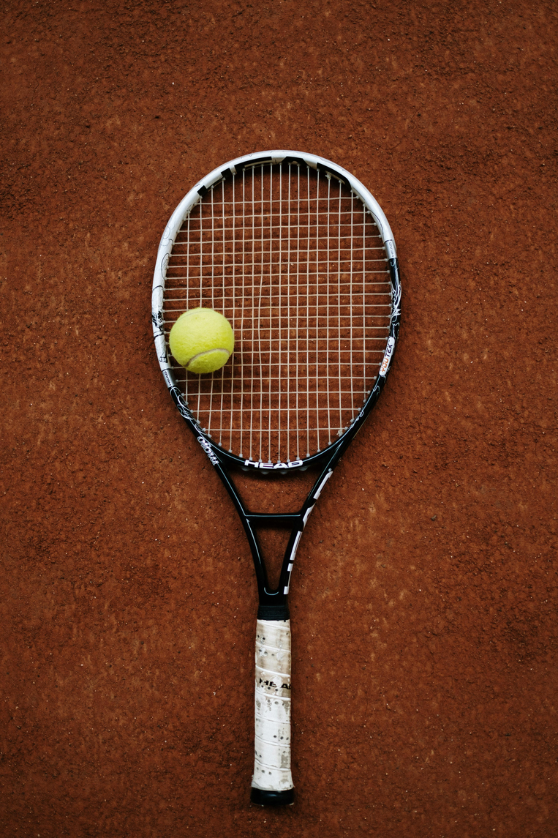
Approach 2 - Steps Implemented
Dataset Preparation
“Positive Images”/Training set: manually-annotated 250 guitar images from Thomann via the OpenCV Haar Annotation Tool.
“Negative Images”/Testing set: diverse samples of non-guitar images drawn from stock image websites (50 images total).
All images converted to resized (600x600) and converted to grayscale.
Gaussian smoothing was implemented for noise reduction.

Slide 19
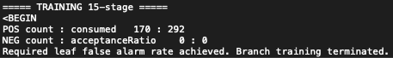
Approach 2 - Steps Implemented
Training based on the AdaBoost algorithm
Sticked to the enhanced implementation of Viola and Jones (2001).
Considered a 24x24 sliding window, allowed for 15 training stages, with a max false alarm rate of 0.3.
Performance Metrics: false negative/alarm rate - “achieved” with 15 rounds of training.
Number of unique features given windowSize [24,24] : 261600

Slide 20
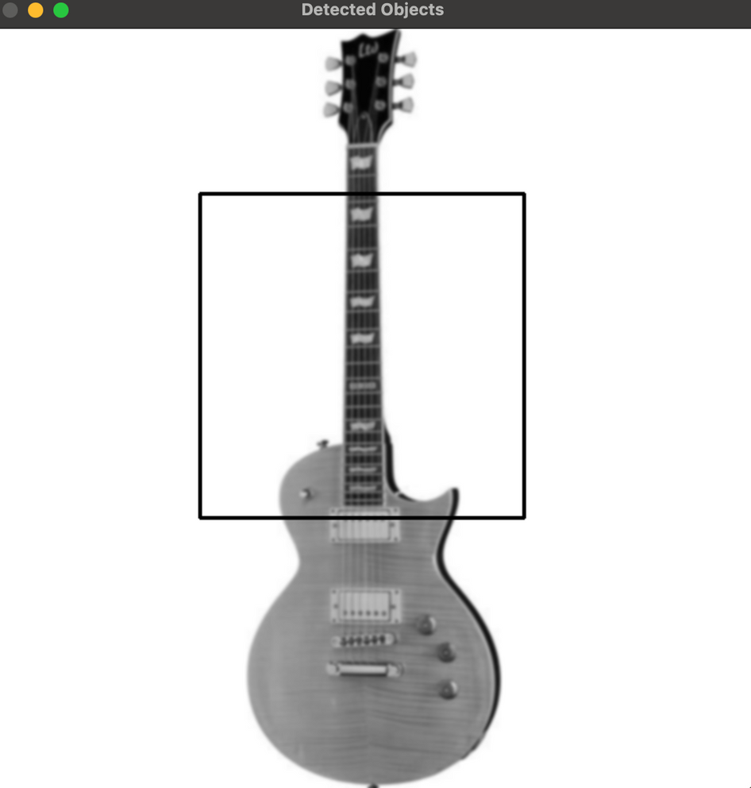
Approach 2 - Results
Very Limited Training Period - Less than 90'
The algorithm seems to have been able to only capture the ‘neck’ feature of guitars.
Due to the very limited performance, we abandoned this approach.

Slide 21
Approach 3 - Dominant Gradient Orientation-based Template Matching
Motivation
Extremely high simplicity of the first naive approach, and very bad results of the second one.
Extremely interesting paper by Daftry et al. (2021) on how NASA utilized this approach for sample-tube detection on its Perseverance rover on Mars.
Promised a color- and contrast-agnostic system, working well on texture-less objects.
Basis of this approach: the gradient orientations of the dominant (gradient magnitude-wise) color channel on the silhouette/outline of the features of interest.

Slide 22
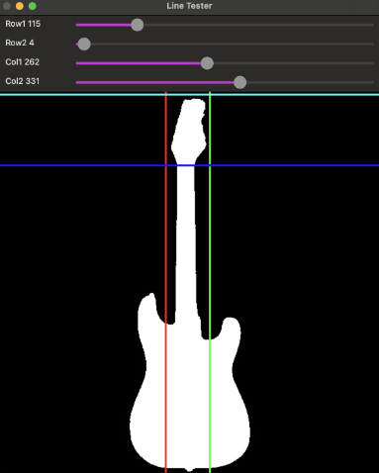
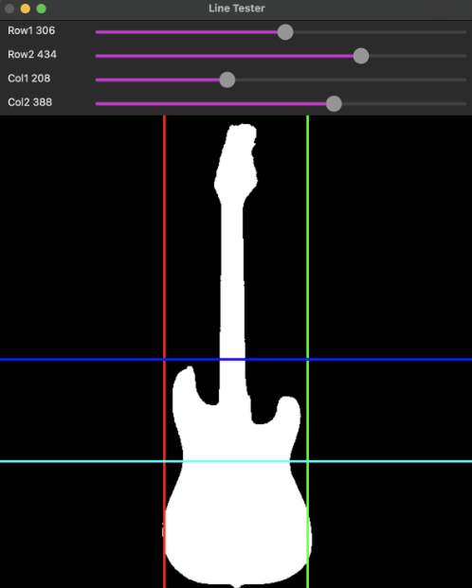
Approach 3 - Dominant Gradient Orientation-based Template Matching
Methodology for Template Creation
Out of our experience - two guitar features are the most telling of its body type; the head and the upper parts of its body.
Our previously used “positive” images served us well in creating templates for these two features based on these features.

Slide 23
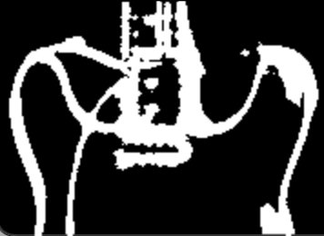

Approach 3 - Dominant Gradient Orientation-based Template Matching
Methodology for Template Creation
For each type of guitar: iterated over all relevant images (after Gaussian blurring on each color channel, separately).
Every pixel of these two features was represented by the gradient orientation value of the color channel bearing the highest gradient magnitude

Slide 24
Approach 3 - Dominant Gradient Orientation-based Template Matching
Methodology for Template Matching
Retained the same considerations pertaining to image pyramids and rotation augmentation.
Target images were represented as well based on their dominant gradient orientation on each pixel.
However, different thresholding values were necessary for matching the two different types of templates.

Slide 25
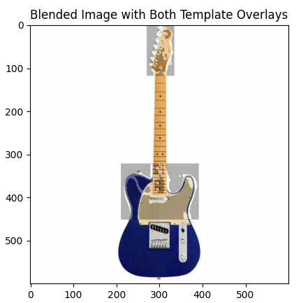
Approach 3 – Approach & Steps to Achieve
Edge Detection Preprocessing: We applied Gaussian blur and Canny edge detection to enhance edge features and improve template matching accuracy.
before proceeding to:
Gradient Orientation Calculation: We used dominant gradient orientations after edge detection to focus on key directions, improving rotation matching.
Different Templates Handling: We used distinct preprocessing for head and upper body templates to preserve their unique features for better matching.
Template Rotation Fix: We resized rotated templates to prevent clipping and ensure they fit within the desired dimensions.

Slide 26
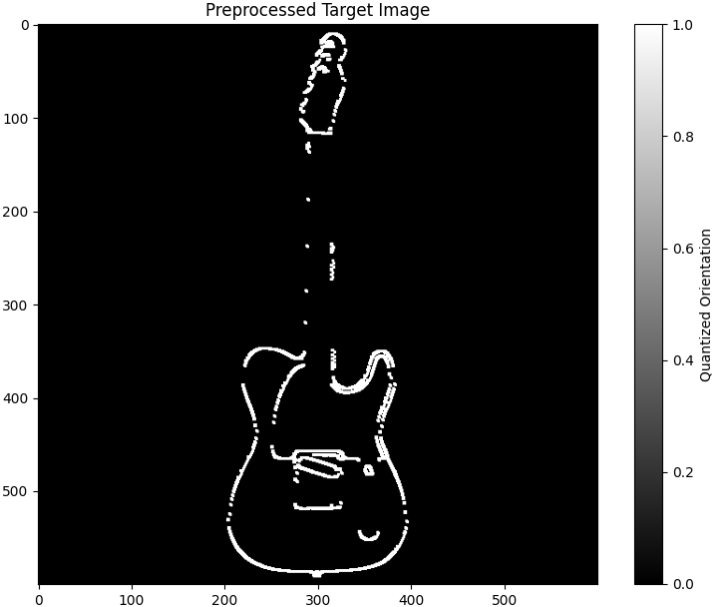
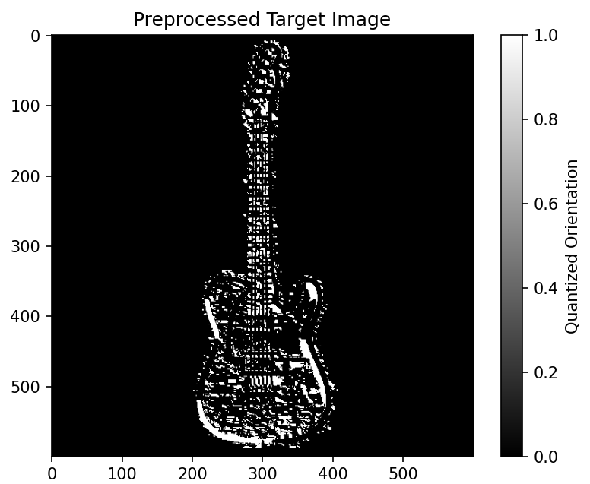
Approach 3 –Issue & Debugging
Canny Edge Detection Impact: Reapplied Canny edge detection after blurring to reduce noise and improve edge clarity for better matching.
Threshold Optimization: Fine-tuned edge detection thresholds for optimal sensitivity and accurate template matching.
Rotation and Size Debugging: Resized templates to avoid clipping during rotation, improving match quality.
Improved Matching: Combined edge detection and gradient orientation to improve overall template matching results.
Iterative Debugging: Tested and refined preprocessing techniques for different templates, leading to better matching accuracy.

Slide 27
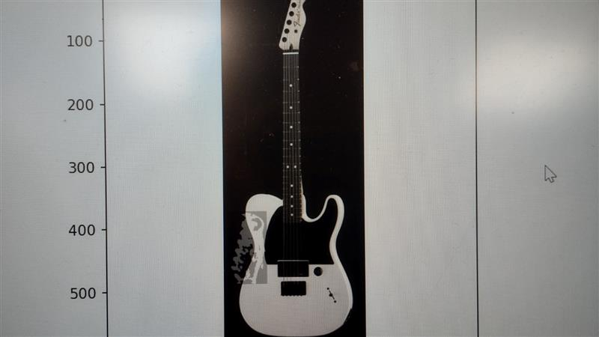
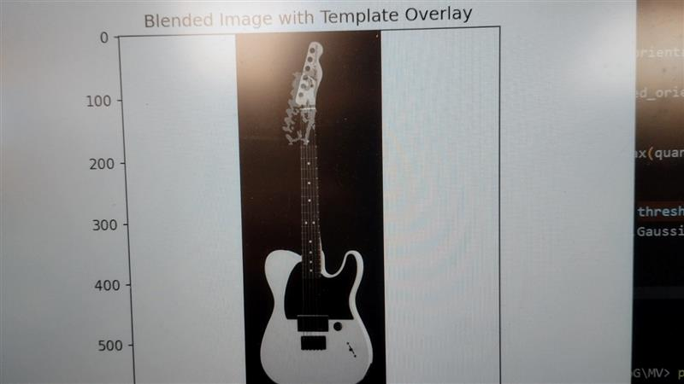
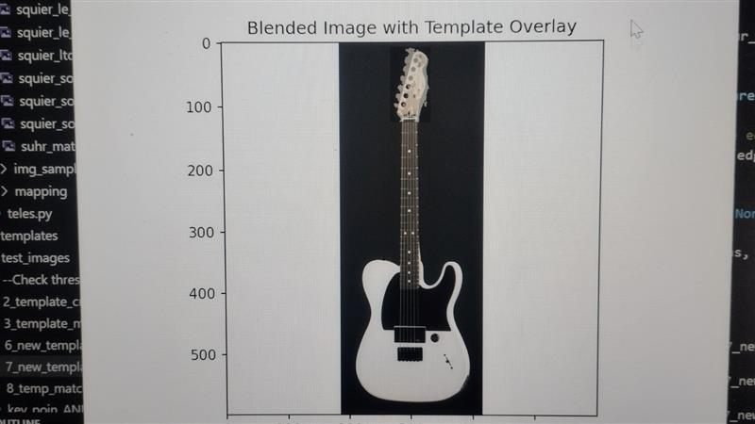
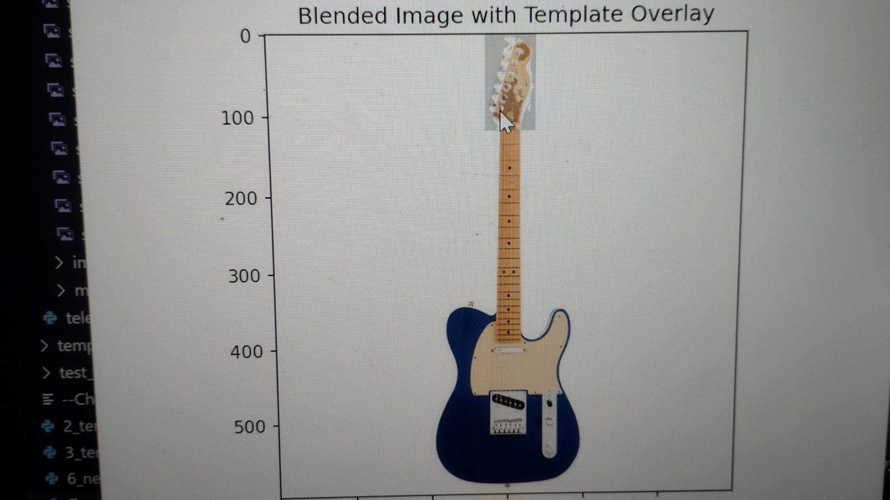
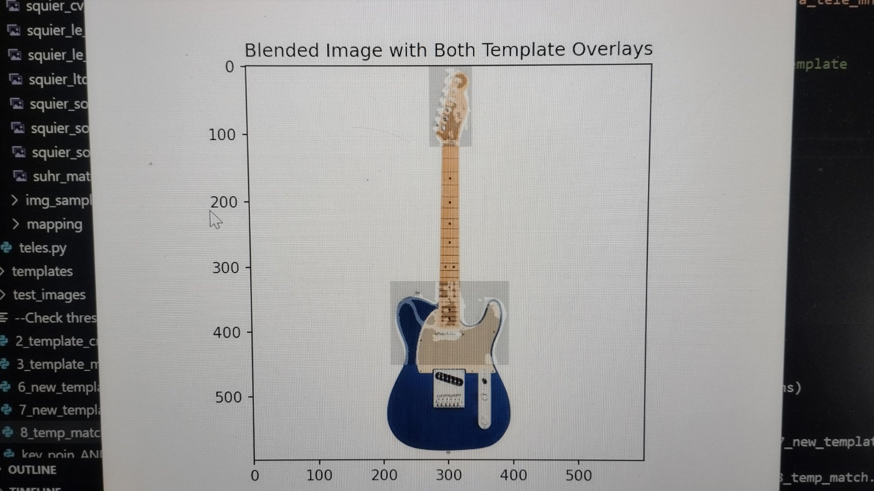
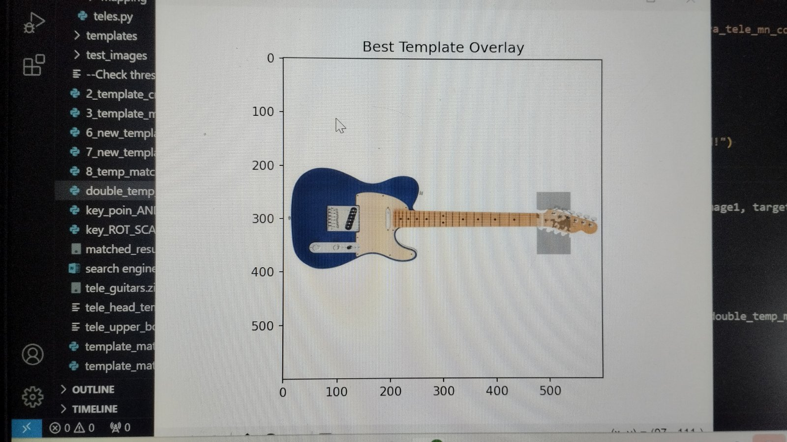
Approach 3 –Debugging and Progress
Step 1 Step 2 Step 3
Step 4
Step 5
Step 6

Slide 28
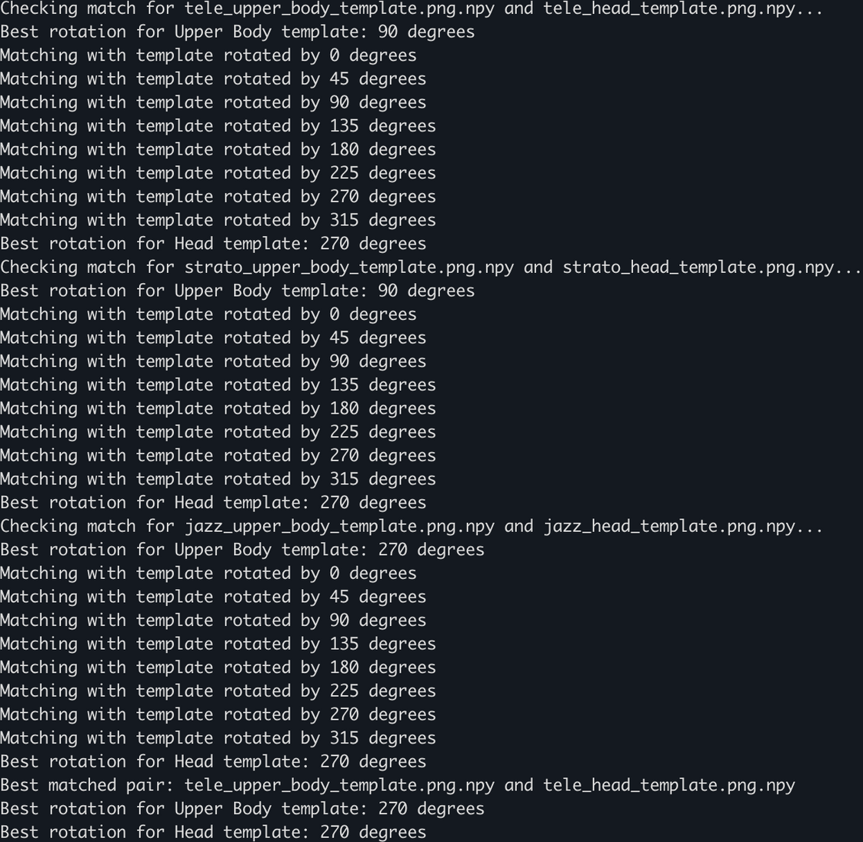
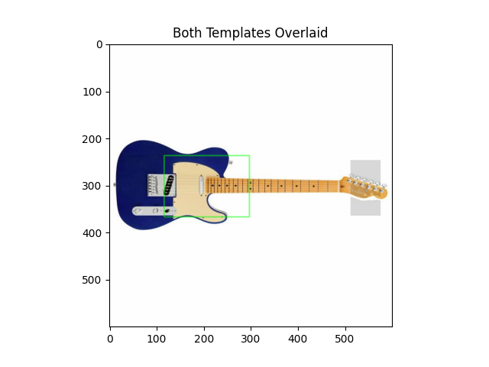
Approach 3 - Matching Example

Slide 29
Conclusions
Implemented a generalized guitar body detection system using three distinct techniques: a naive approach using template matching as offered by the cv2 library, one based on the dominant gradient orientation, and a Haar-based method (which could not be finalized).
Addressed variations in scale, rotation, and background through dynamic preprocessing and multi-scale matching across all approaches.
Faced challenges related to image anomalies on cases with irregular background or rotation.
The dominant gradient orientation proved to be the most effective approach, offering the best performance for guitar body-type recognition.
A significant consideration relates to the computational efficiency, as the current implementation takes several minutes per iteration, making it impractical for use in a video version as suggested in the original paper used by NASA.

Slide 30
Thank you for your attention!

